Slide 1
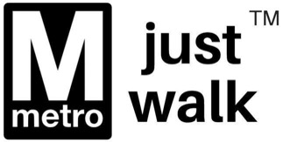
Improving Public Transportation in the DMV Area
Nelson Foster & Darius Bailey
DATS 6202

Slide 2
Machine Learning can be leveraged to improve public transit in several areas
Pricing
Routes
Maintenance
Optimization to balance public transit ridership with private vehicle ridership appropriately (transit ecosystem)
Enabling more dynamic pricing structures
Demand-based pricing tied to the overall transportation system
For non-rail options, revisit route optimization, with consideration to traffic patterns
For rail-based options better predict growth / investment opportunities
Adopting “Predictive Maintenance” approach to intelligently automate inspection and maintenance schedules
Link supply chain management of component parts and materials to automated Predictive Maintenance processes
Scheduling
Public Safety
Utilize predictive models keyed to population growth, peak times, and maintenance schedules to optimize arrival, departure, and cadence
Demand-based scheduling adjustments in near real-time
Threat prediction and assessment
Emergency response
Rider Risk Mitigation: Collision, fire, accident, mechanical failure

Slide 3
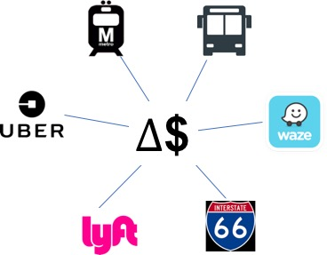
Pricing
Dynamic pricing could help smooth demand, ease traffic, and increase profitability of the system
Ride sharing companies have long leveraged Machine Learning to dynamically adjust pricing and determine customer price elasticity (Uber uses predictive modeling to charge what customers might be willing to pay)
Toll-roads have leveraged congestion pricing to ensure continuous traffic flow. Machine Learning could help identify price elasticity to dynamic pricing
An eventual destination could be a system that accounts for conditions across bus, rail, and car to determine a pricing structure that proactively balances load on the overall infrastructure

Slide 4
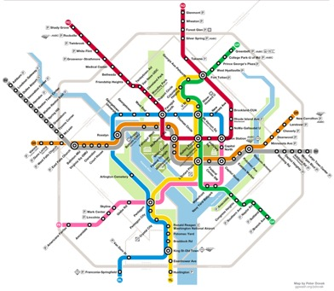
Routes
ML in routing could identify alternate routes to meet demand or identify areas to invest
Waze’s routing algorithm uses historical trends as well as real-time input from users to optimize routes
Metro bus routes could leverage similar logic to optimize AM / PM or weekend routes
Metro rail can leverage predictive modeling to identify areas of growth that will benefit most from additional investment
AM Route
PM Route

Slide 5
Maintenance
ML for “Predictive Maintenance” and Automated Supply-Chain Management
Mechanical failure due to aging equipment has a significant impact on Metrorail’s ability to prevent scheduling delays
According to the Metrorail’s 2017 Engineering & Maintenance Comprehensive Internal Review, “Effective management of supply chain systems is essential to the availability of parts/materials and reducing the number of stockouts”
Employing Machine Learning methods to analyze and predict “mean-time-to-fail” or other elements to anticipate when component parts need inspection, maintenance or replacement could assist supply chain managers with ensuring the right parts are in stock, and potentially reduce the likelihood of avoidable mechanical failure
Big Data Republic proposes several approaches to using Machine Learning for “Predictive Maintenance”

Slide 6
Maintenance
ML for “Predictive Maintenance” and Automated Supply -Chain Management (Cont’d)
Strategies for Machine Learning in Predictive Maintenance Models*
Regression Models to predict “Remaining Useful Lifetime”
Classification Models to predict failure within a given window
Flagging anomalous behavior
Survival analysis models for predicting probability of failure over time
All four strategies are predicated on data availability, extensive domain knowledge, and analytical expertise
These and other methods could be used to add automations to maintenance schedules as well as supply chain management tools.
*Source: Big Data Republic, 2015
Notes:
“The success of predictive maintenance models depend on three main components: having the right data available, framing the problem appropriately and evaluating the predictions properly.” -Big Data Republic, 2015

Slide 7
Scheduling
ML for Dynamic, Real-time Schedule Adjustments
Delay-causing issues such as mechanical failures, track problems, and other equipment problems are compounded in the absence of dynamic, adaptive scheduling methods
Use WMATA’s Transparent Data Sets API to accumulate real-time train position, scheduling, outage, routing and ridership data to build models for the most efficient dynamic scheduling
Revisit automations so that changes in the scheduling algorithm can be adjusted for unexpected failures in near-real time
Applications of such methods have been researched by the Singaporean Agency for Science, Technology & Research to predict ridership in an effort to “…understand the recipe for a ’smart city’” and reduce gridlock between central business districts and residential areas during peak hours.

Slide 8
Public Safety
ML for Predictive Threat Detection; Automations to Protect Public Safety
In public transit, the two predominant safety considerations are accident and violence/crime prevention
A combination automation in maintenance, scheduling, and route optimization will reduce the potential for collisions or other accidents due to equipment failure
Implementing intrusion and anomaly detection software on WMATA’s networks and employing real-time surveillance in, on, and around metro stations will help mitigate the potential for external threats to public
Efforts should be supported by seamless coordination with partner law enforcement and public safety entities

Slide 9
References
References
Impact of Artificial Intelligence on Public Transportation and Urban Mobility. (November 23, 2017). Retrieved from http://www.trackcompanybus.com/will-ai-impact-public-transportation-urban-mobility/
Jha, Vishal (December 2015) Study of Machine Learning Methods in Intelligent Transportation Systems (Retrieved From https://digitalscholarship.unlv.edu/cgi/viewcontent.cgi?article=3544&context=thesesdissertations
Machine Learning for Predictive Maintenance: Where to start? (Copyright 2015). Retrieved from https://www.bigdatarepublic.nl/machine-learning-for-predictive-maintenance/
Machine-learning program predicts public transport use in Singapore (January 25, 2017). Retrieved from https://phys.org/news/2017-01-machine-learning-singapore.html
Metrorail Comprehensive Internal Review Summary (November 2017). Retrieved From https://www.wmata.com/initiatives/transparency/upload/Summary-Page-Metrorail-Engineering-and-Maintenance-2017.pdf
When Artificial Intelligence Rules The City (May 17, 2017). Retrieved from https://www.citylab.com/life/2017/05/when-artificial-intelligence-rules-the-city/509999/

